Slide 1
Marketing Lecture # 20 Muhammad asad Instructor department of computer science

Slide 2
Key Learning Point :-
- Discussion about the market Mix --- Product

Slide 3
PRODUCT MIX
Essential decisions related to product quality, design, packaging and variety, and etc. --- That a producer offers to the market.
COMPONENTS OF PRODUCT MIX
1: BRANDING
2: PACKAGING
3: LABELLING

Slide 4
2: PACKAGING
The process of developing, designing and producing a container or wrapper of a product --- It is one of the most important functions of marketing.
LEVELS OF PACKAGING
There are three levels of packaging which are primary package, secondary package and transportation / shipping package.

Slide 5
PRIMARY PACKAGING
The package, which has enclosed the actual commodity --- Such package remains attached with the actual commodity until the consumers have completely used it --- Its main purpose to protect the product and inform or attract a customer.
EXAMPLE
Tooth paste tube, bottles of medicines, cigarette packets, match box and etc.

Slide 6


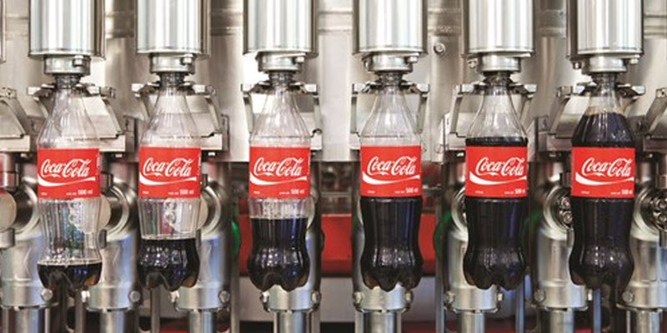
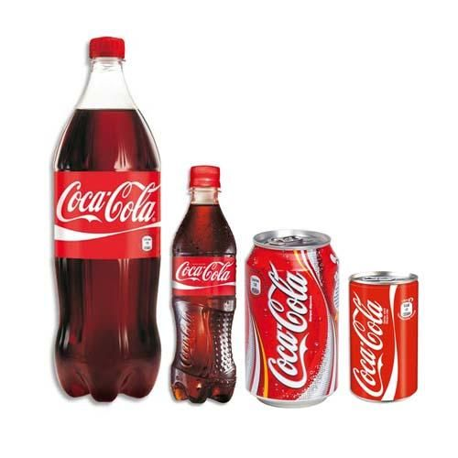


Slide 7
SECONDARY PACKAGING
The layer of the cover is added to the primary package for its protection --- After bringing the product home or being ready to use the product --- The secondary package is taken-off or thrown --- The consumers do not keep secondary package for long --- Its main purpose to protect products and provide branding during shipping.
EXAMPLE
The cardboard-box in which tube of toothpaste is packed, the cover of soap and etc.

Slide 8
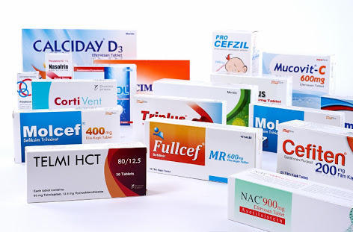
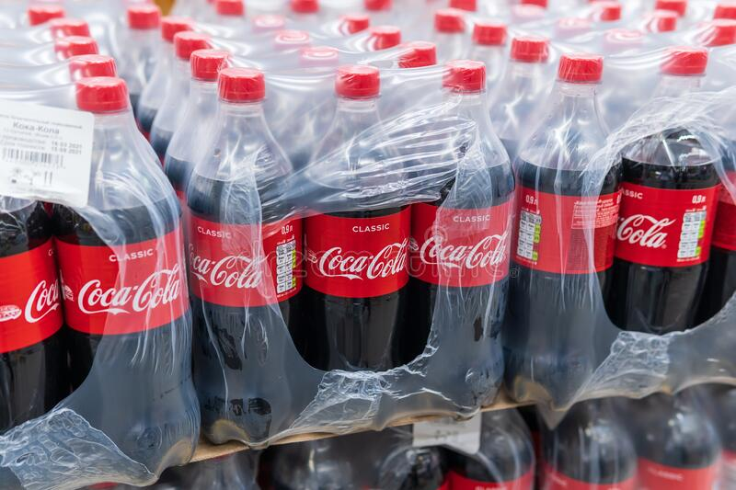

Slide 9
TRANSPORTATION / SHIPPING PACKAGING
Is used to facilitate, the identification, transportation, and storing of the products --- It essential is to keep them stored for a long time, to carry them far away, and need to be loaded and unloaded several times --- Under the shipping package, there may be many primary and secondary packages. Its main purpose is to properly protect shipments --- During their time in transit.
EXAMPLE
Wooden boxes, cartons, cardboard boxers, plastic boxes and etc.

Slide 10
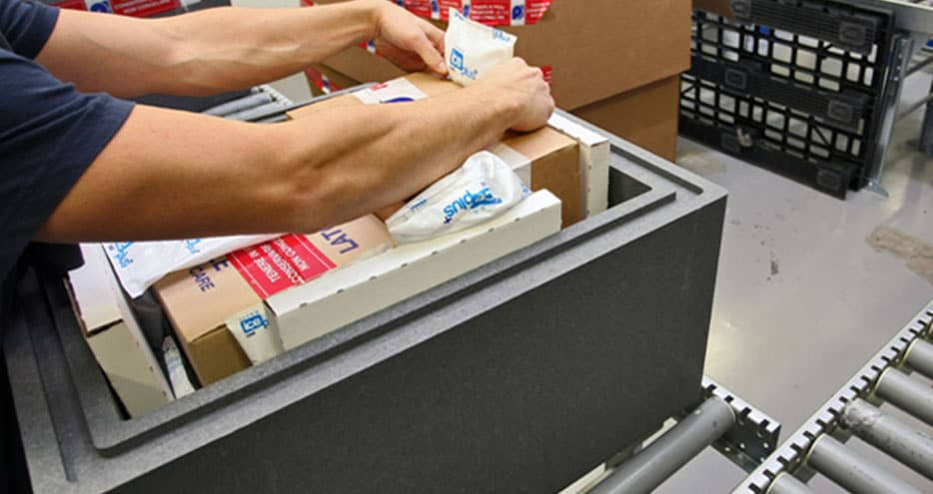
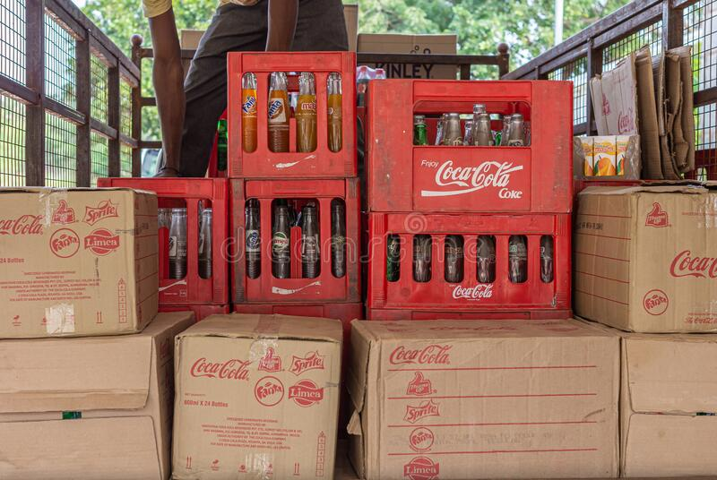

Slide 11
FUNCTIONS RELATED TO PACKAGING
PROTECTION --- Proper packaging protects the product from any kind of damage. Such as, chips are packed in air tight containers/packets.
IDENTIFICATION --- Packaging helps to identify the product easily. Such as, in a Dove product, the pure white and blue packaging and the letter D can be recognized from a distance.
CONVENIENCE --- Packaging enables the consumer to handle the product conveniently. Such as, milk packed in packets and cold drinks in bottles are convenient to shift from one place to another.

Slide 12
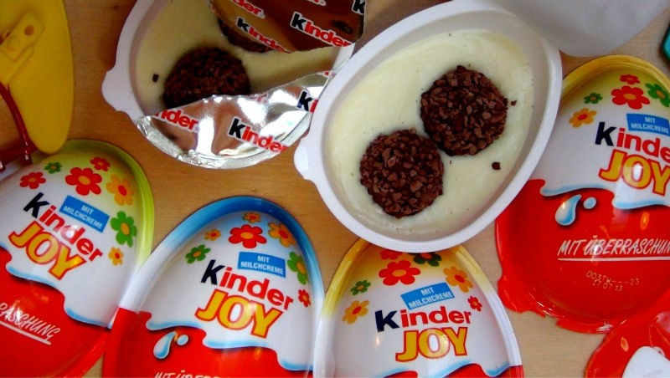
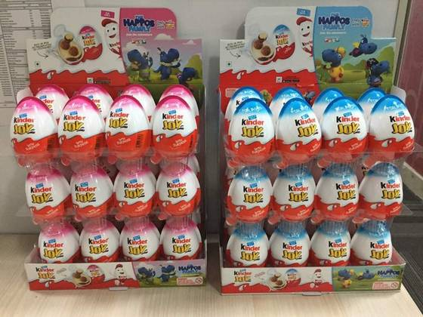
PROMOTION --- Packaging helps to promote the sale of the product. Such as, Kinder Joy chocolate’s attractive packaging encourages customers to buy the product.

Slide 13
IMPORTANCE OF PACKAGING
RISING STANDARD OF HEALTH AND SANITATION --- Packaged goods are preferred, as the chances of pollution or adulteration of products are less.
SELF-SERVICE OUTLETS --- Products with attractive packaging are picked by consumers in such stores.
PRODUCT DIFFERENTIATION --- Packing enables consumers to differentiate between products on the basis of its size, color or material of packaging.

Slide 14
INNOVATIVE OPPORTUNITIES --- Innovative methods of packaging enable to improve the scope of marketing the products. Such as, products now can remain fresh for a longer period of time without refrigeration. Hence, such a feature can be used for marketing the product.

Slide 15
3: LABELLING
The process of providing information about the product --- In the form of a tag or a label on the package of the product.
Information provided on these tags or labels contains descriptions about a product’s name, date of manufacturing & expire, quality, price, contents, method of use and etc.

Slide 16
FUNCTIONS RELATED TO LABELLING
DESCRIPTION OF USE AND CONTENTS --- A label describes the product and specifies its components or other useful information. Such as, contents of the product, the caution to be taken while using it, the procedure of use and etc. Like, soup ingredients along with the procedure of preparation are mentioned on a packet of soup.

Slide 17
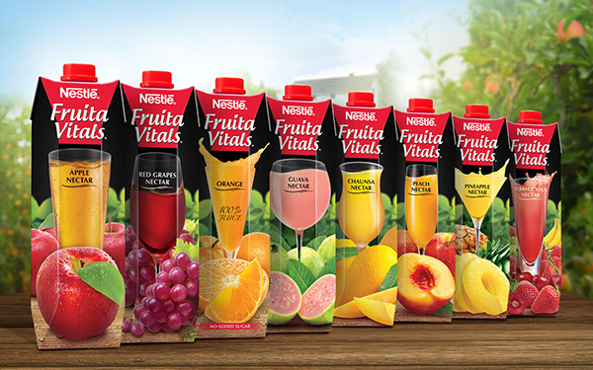
GRADING --- Enables grading of the product into various categories. Such as, the brand Nestle sells various flavors of Fruita Vitals under different label categories.

Slide 18
IDENTIFICATION --- Helps consumers in identifying the product or brand. Such as, name of the product is printed on the package which makes identification of one’s favorite brand much easier. Similarly, the label provides other useful information as well such as the contents of the product, weight of the product and maximum retail price.
PROMOTION OF THE PRODUCT --- A label helps in attracting customers, thereby enabling promotion of the product. Moreover, any information regarding the sales promotion schemes is provided by the label.

Slide 19

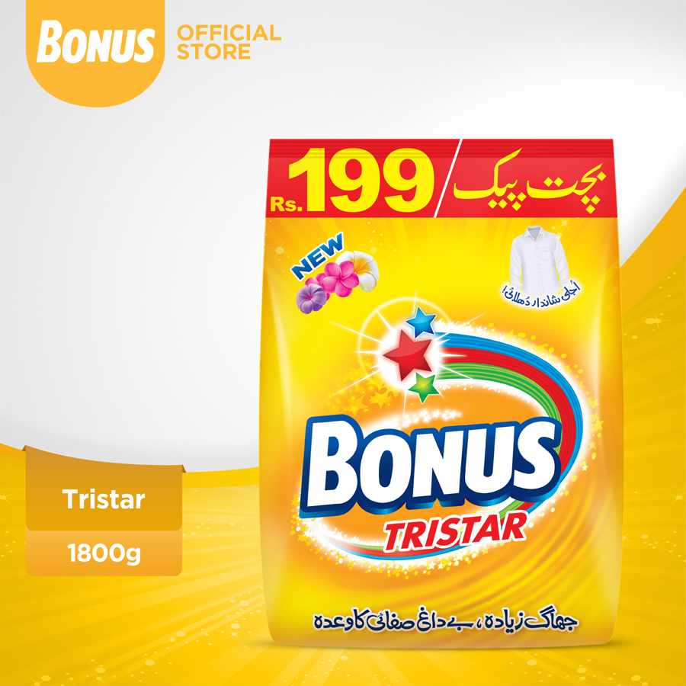
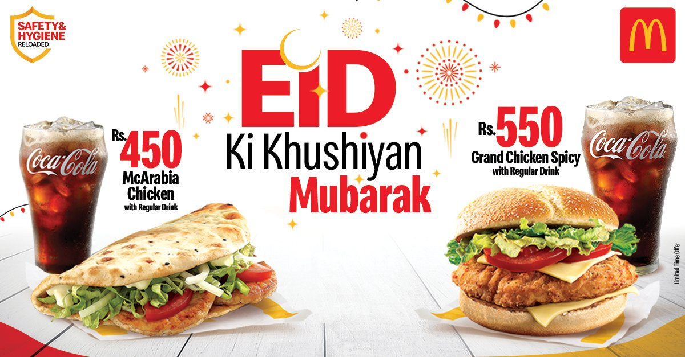

Slide 20
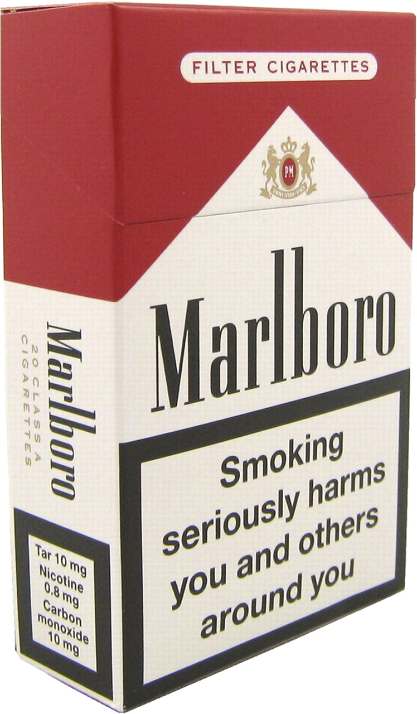
INFORMATION REQUIRED ACCORDING TO LAW --- Information as required by the law is also provided by the label of the product. Such as, it is mandatory for tobacco-producing companies to print a warning message on the packet of the product.

Slide 21

ANY QUESTION
You can contact me at: asadali@uosahiwal.edu.pk
Your query will be answered within one working day.

